Slide 1
FEIGNER EFFECTIVE EXPERIENCE SECTIONS
action verb
+ phrase describing result
+ phrase describing task
+ phrase describing solution

Slide 2
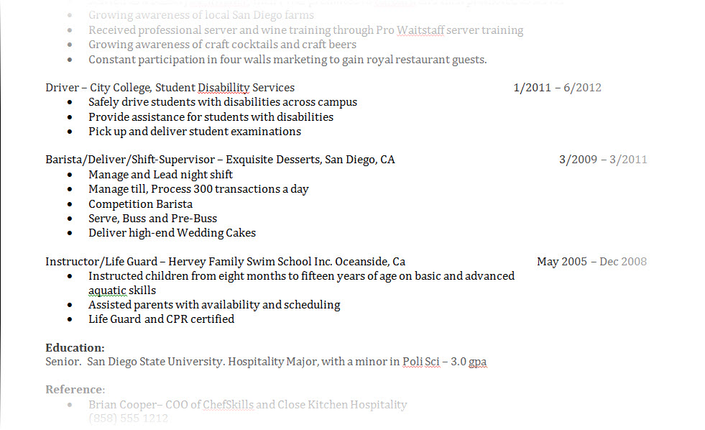
Avoid Simply Listing Your Duties

Slide 3
Use the “Problem-Task-Solution-Result” Format
Problem: Your company had trouble with its customer service. Your resume draft’s very vague description of the issue . . .
Improved customer service

Slide 4
Use the “Problem-Task-Solution-Result” Format To Effectively Capture your Role
Formula:
action verb + phrase describing result + phrase describing task + phrase describing solution

Slide 5
Using the “Problem-Task-Solution-Result” Format Example
Improved customer service by identifying customer buying patterns and creating personalized product packages
Task

Slide 6
Using the “Problem-Task-Solution-Result” Format Example
Improved customer service by identifying customer buying patterns and creating personalized product packages
Solution

Slide 7
Using the “Problem-Task-Solution-Result” Format Example
Result
(Good)
Improved customer service by identifying customer buying patterns and creating personalized product packages

Slide 8
Using the “Problem-Task-Solution-Result” Format Example
Improved customer service by identifying customer buying patterns and creating personalized product packages
Increased customer loyalty by 30% in six months
Result
(Better)

Slide 9
Using the “Problem-Task-Solution-Result” Format Example
Improved customer service by identifying customer buying patterns and creating personalized product packages
Increased customer loyalty by 30% in six months
Added 22 new client referrals within three months
Result
(Best)

Slide 10
SUMMARY EFFECTIVE EXPERIENCE SECTIONS
Use PTSR to describe experience/accomplishments
action verb
+ phrase describing result
+ phrase describing task
+ phrase describing solution
Quantify your experience

